Slide 1

Garbage collection
Notes:
Just into on why we’re here today and what’s the point of having this presentation. Brifely touch the topic of presenters: SZ, OZ, IL, and KK.
In the end: passing the floot to Sviatlana.

Slide 2
Memory management
Automatic Memory Management
Java
C#
Manual Memory Management
C\C++
Pascal
JavaScript
Other
Rust
…
…
Python
…
Fortran

Slide 3
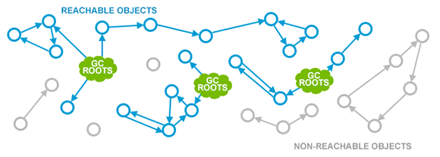
What is garbage?

Slide 4
GC roots
Class: Classes loaded by a system class loader; contains references to static variables as well
Stack Local: Local variables and parameters to methods stored on the local stack
Active Java Threads: All active Java threads
JNI References

Slide 5
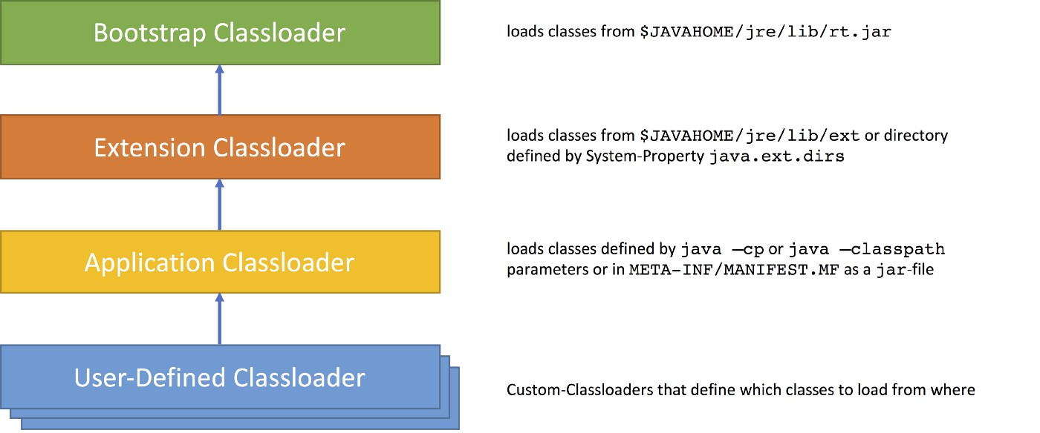
System\Application Classloader

Slide 6
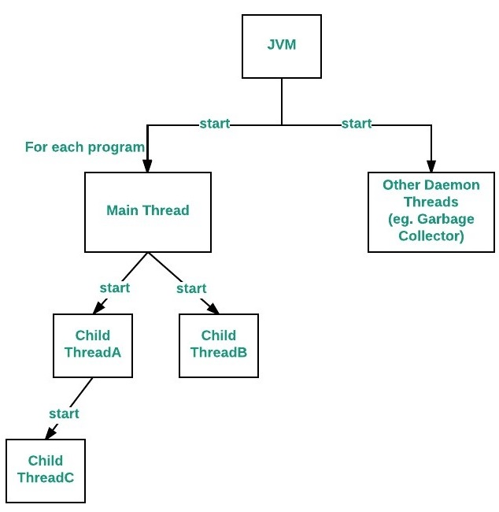
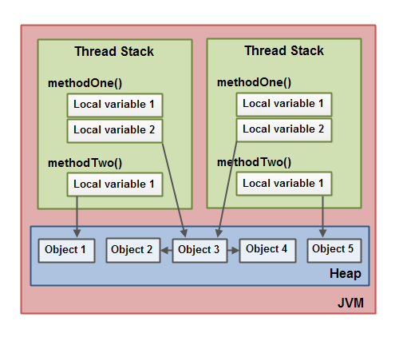
Stack Local Active Java Threads

Slide 7


Slide 8
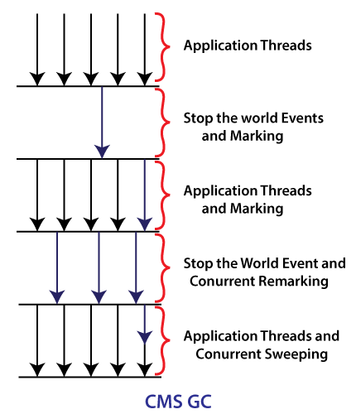
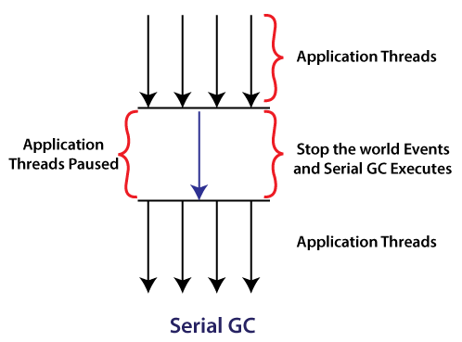
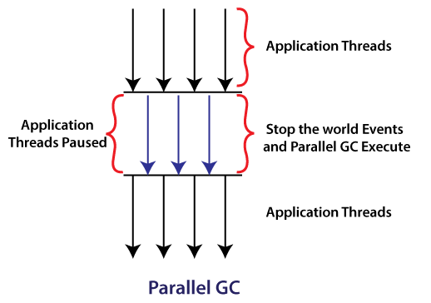
GC algorithms
Serial GC
Parallel GC
CMS GC

Slide 9
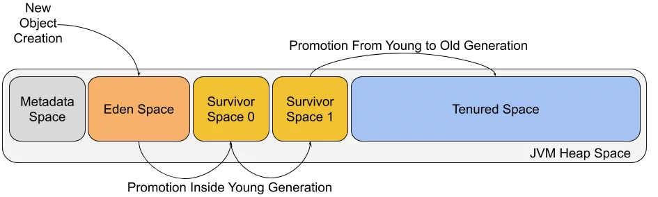
Generations
Serial GC
Parallel GC
CMS GC

Slide 10
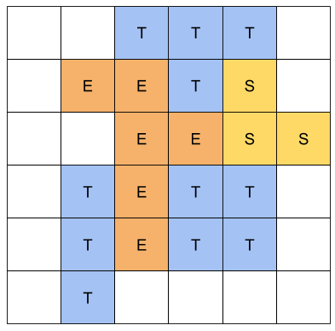
G1 GC
java -XX:+UseG1GC -jar Application.java

Slide 11
Demo time
-XX:+UseSerialGC
-XX:+UseParallelGC
-XX:+UseG1GC

Slide 12

Bad practice
System.gc()
finalize()
Static variables
Unclosed resources
Improper equals() and hashCode() Implementations
Inner Classes That Reference Outer Classes

Slide 13
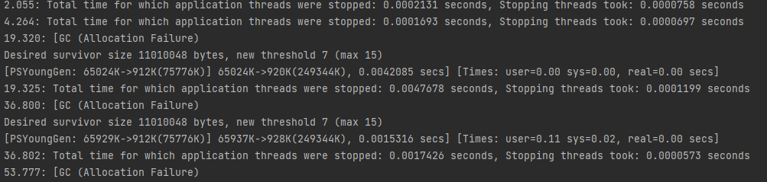
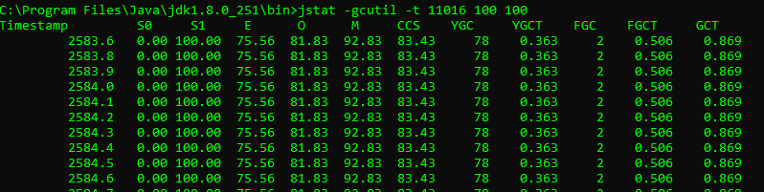
Monitoring tools
VM Options:
-XX:+PrintGCDetails
-XX:+PrintGCTimeStamps
-XX:+PrintClassHistogram
-XX:+PrintTenuringDistribution
-XX:+PrintGCApplicationStoppedTime
-XX:+HeapDumpOnOutOfMemoryError
Command line tools:
jstat -gcutil -t <pid> <interval> <number_of_samples>

Slide 14
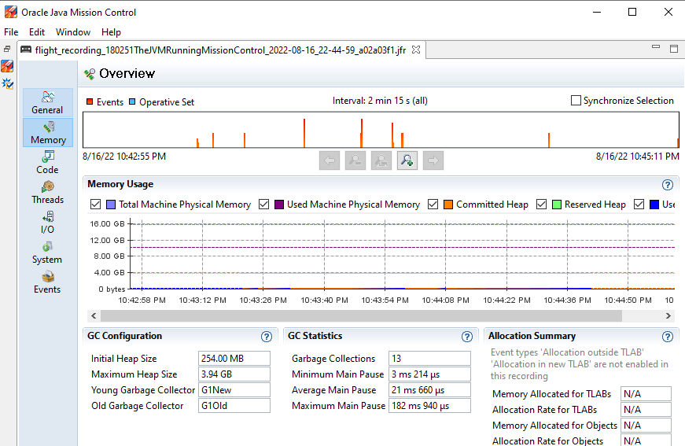
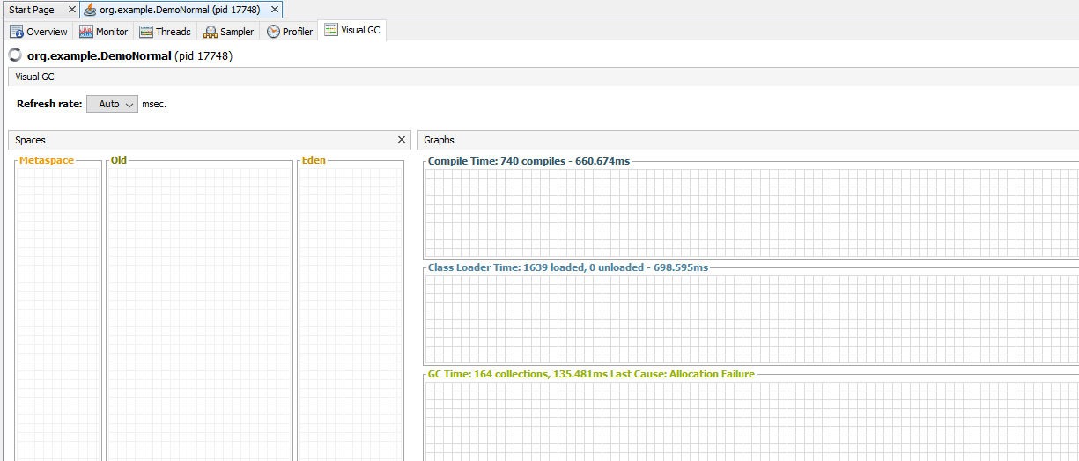
Java Mission Control
VisualVM + VisualGC

Slide 15
Tuning
Controlling Heap:
-Xms2g -Xmx2g
-XX:InitiatingHeapOccupancyPercent
-XX:MinHeapFreeRatio
Garbage Collector:
-XX:+UseSerialGC
-XX:+UseParallelGC
-XX:+UseG1GC
Controlling generations:
-XX:YoungGenerationSizeIncrement
-XX:TenuredGenerationSizeIncrement
Tuning for throughput:
-XX:MaxGCPauseMillis
-XX:ReferencesPerThread

Slide 16
QA
Do you have any questions?

